Slide 1

Modern agile software Development

Slide 2
1. What is Agile Software Development.
a) New SDLC Flow
b) CI/CD Framework(tools to be used)
2. As Is
3. To be
4. Gap Analysis
5. Demo
Developer Experience
Tester Experience
c) Operation Experience

Slide 3
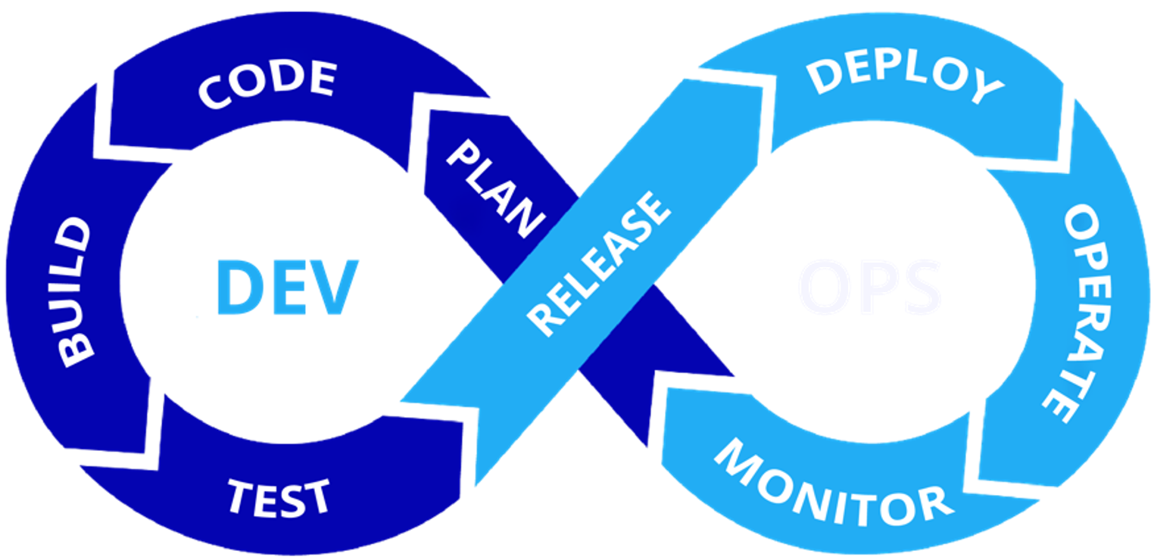
New SDLC Flow
DEV
OPS
Planning
DevOps teams get more done and solve problems faster

Slide 4
Why adopting Agile:

Slide 5






b) CI/CD Framework(tools to be used)
Version Control
Build
Testing
Deploy
Planning
Kube Manager

Slide 6


KubeManager
Traditional
Cloud-native
Kubernetes
VM
VM
VM
VM
VM
VM
App
App
App
App
App
App
App
App
App
Docker
Docker
Docker
Highly reliable and performance-optimized virtualization platform for traditional apps
Enterprise-level container platform based on K8s for
cloud-native apps
Sangfor HCI software
+
standard x86 servers
One platform for both types of workloads Shared storage and network resources
Smooth transition to cloud-native

Slide 7
Journey to Agile Development

Slide 8
As Is
Application: ASH (Bank Recon)
Technologies: Cobol + Windows Platform
Application
Application
Application
Guest OS
Traditional Monolithic Architecture
Hypervisor
Challenges in Digital
Tightly Coupled
Slow to Change
Scales Vertically
Infrastructure and Platform Dependent
Pre-Provisioned for Peak
Challenge to Maintain and Operate
Not COST effective in the long term
Hardware

Slide 9
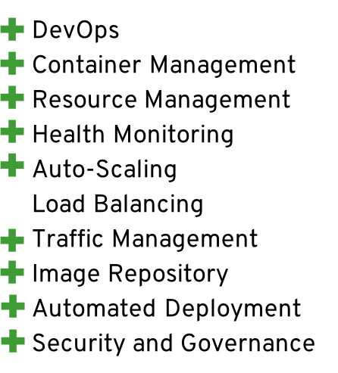
To Be Containerized For Microservices
Application: VRBoM
Technologies: NodeJS & MySQL
Container
Container
Container
Apps
Apps
Apps
Microservice Advantages
Host Minimum OS
Hypervisor
Hardware

Slide 10
4) Gap Analysis
(Need to mention steps involved to move from the existing environment to new SDLC .
Ex:- Application Migration.
Environment setup)
Upgrade the SangFor HCI to version 6.2
Install the KubeManager on the client server
Setup the Agile Development environment
Connect the CICD tools to the KubeManager

Slide 11
5) Demo
Developer Experience:

